Slide 1
SAP SVNT ---Next Popular---
Liwen Feng
10/25/2019

Slide 2
Overview of Team idea
Story/Architecture of contribution
Demo of contribution
What you would do next

Slide 3
Overview of Team idea
Goal: Predict how popular a YouTube video will be
Business constraints:
Time limitation
Resource limitation
Technical constraints:
Data scientist could only do some simple prediction due to limited time
Functional requirements:
Register / login / logout
Upload a video link and get the predicted popularity(main)
Non functional requirements:
Performance
Availability
Accuracy
View Count
Represents
Popularity

Slide 4
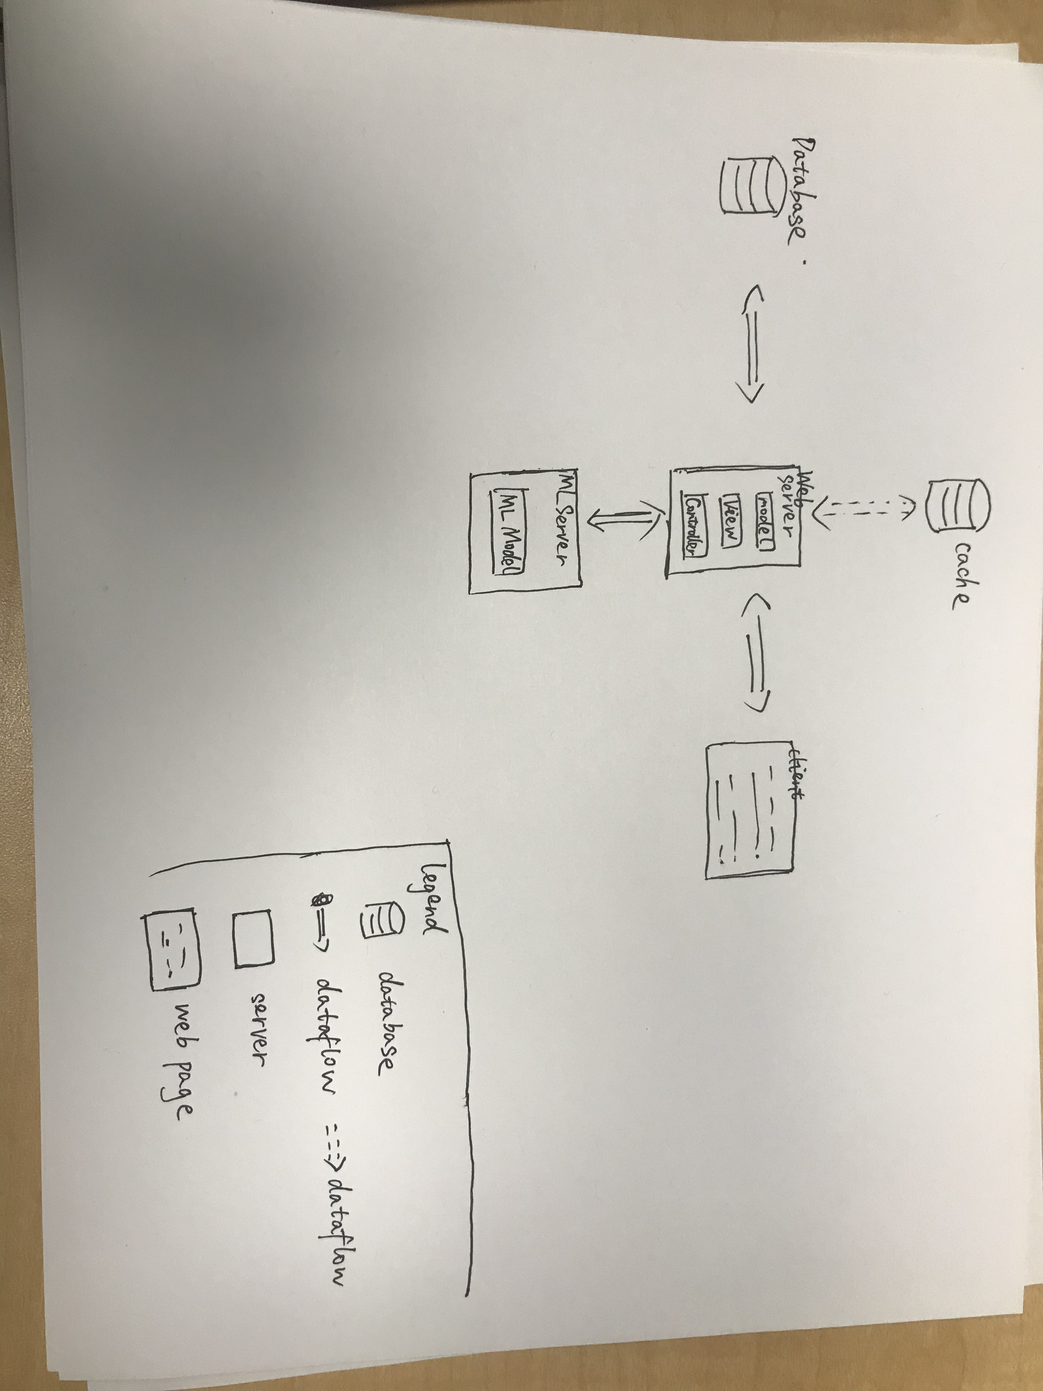
Architecture
Web application vs mobile application
Django
Performance:
Database
Cache
Availability:
Different server for ML Model and web requests handling
Multiple web servers
Accuracy:
Data drift: periodically update model
Notes:
Web -> Mobile takes time to test
Django -> built-in templates, sqlite, mvc
Performance -> one link multiple times
Availability -> craft
Accuracy -> production

Slide 5
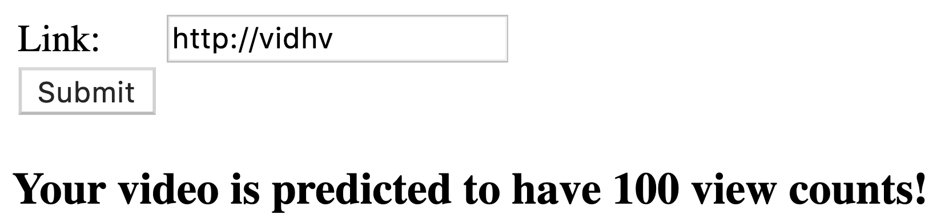
Demo of contribution

Slide 6
Future Improvements
Improve usability with mocked UI
Integrate with Machine Learning model
Form validation
Cache
Scale

